Slide 1

VENDOR RAISE BRIDGING VENDORS & LENDORS
Team Members:
Akhil Duggineni
Kuchipudi Yokshith Sai Ram Chowdary

Slide 2

PROBLEM STATMENT
Vendor Raise is a website that connects vendors with community lenders. Vendors can request small loans. Lenders can view and choose who to support. It’s easy to use and doesn’t require complex steps.

Slide 3

Innovation / Uniqueness
🔹 Focus on small vendors who don’t get bank support
🔹 Local, community-driven micro-lending 🔹 No paperwork or complicated process 🔹 Simple UI for both lenders and vendors 🔹 Search based on loan type, vendor type, and location

Slide 4
TECH STACK:
Frontend: HTML, CSS, JavaScript
CSS Files: style.css, dashboard.css
JS Files: main.js, auth.js
Optional AI tools: Used for content generation
No backend yet (MVP stage)

Slide 5

WORK FLOW
User lands on homepage
Registers as Vendor or Lender
Login to respective dashboard
Vendors create loan requests
Lenders view and respond to requests
Future: Chat, transaction, verification system

Slide 6

Execution Plan
Create static frontend pages (Done)
Add dashboards for vendors/lenders (Done)
Build search page(Done)
Add backend for user data and requests (future)
Deploy for public access(future)

Slide 7

Scalability & Real-World Impact
🌍 Can support vendors in rural and urban areas 📱 Easily accessible from any mobile device 💸 Helps local economies grow 💬 Builds trust between people in the same community 🔗 Can be expanded to different cities and states

Slide 8
Anticipated Challenges
🚫 No backend – data is not stored ⏱️ Limited time – only frontend built 🧠 Need more logic for matching vendors and lenders 🔐 Need authentication & data privacy 💬 Real-time communication not yet included

Slide 9

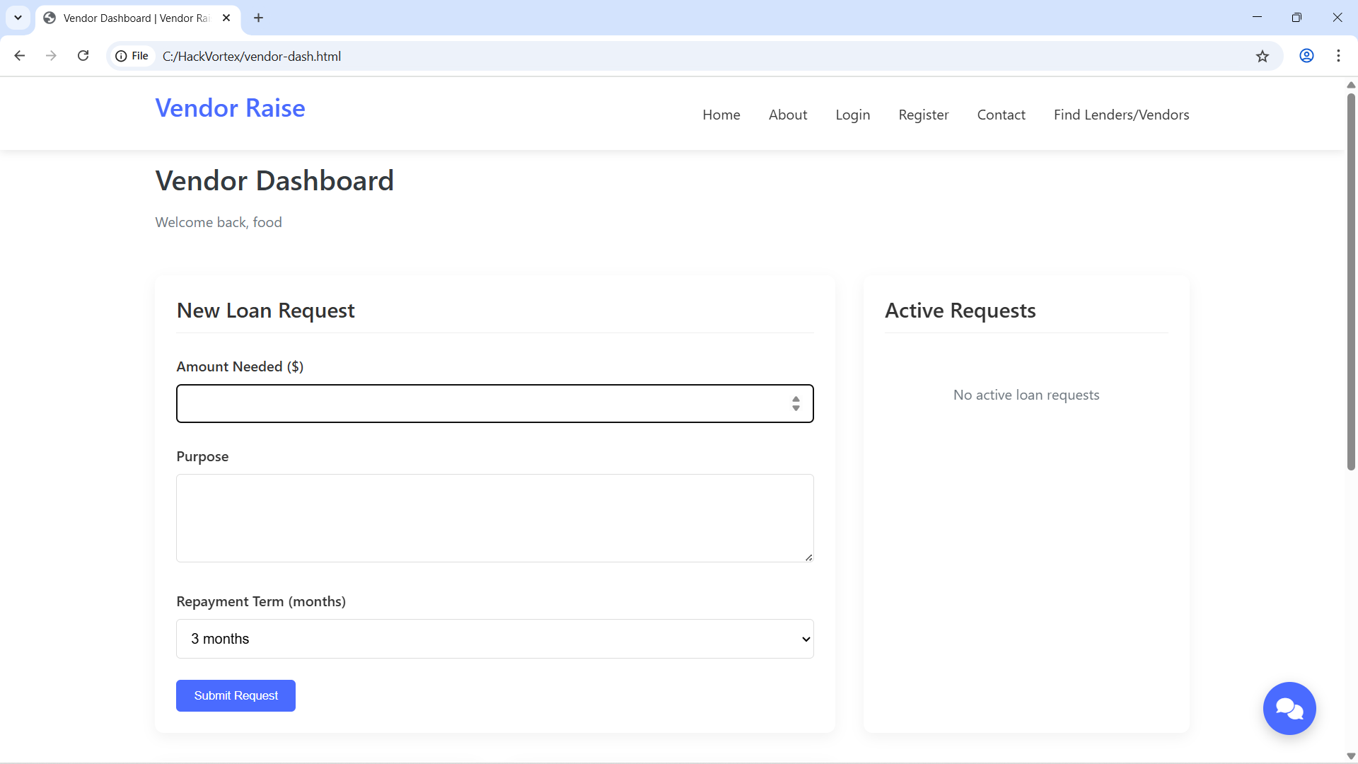
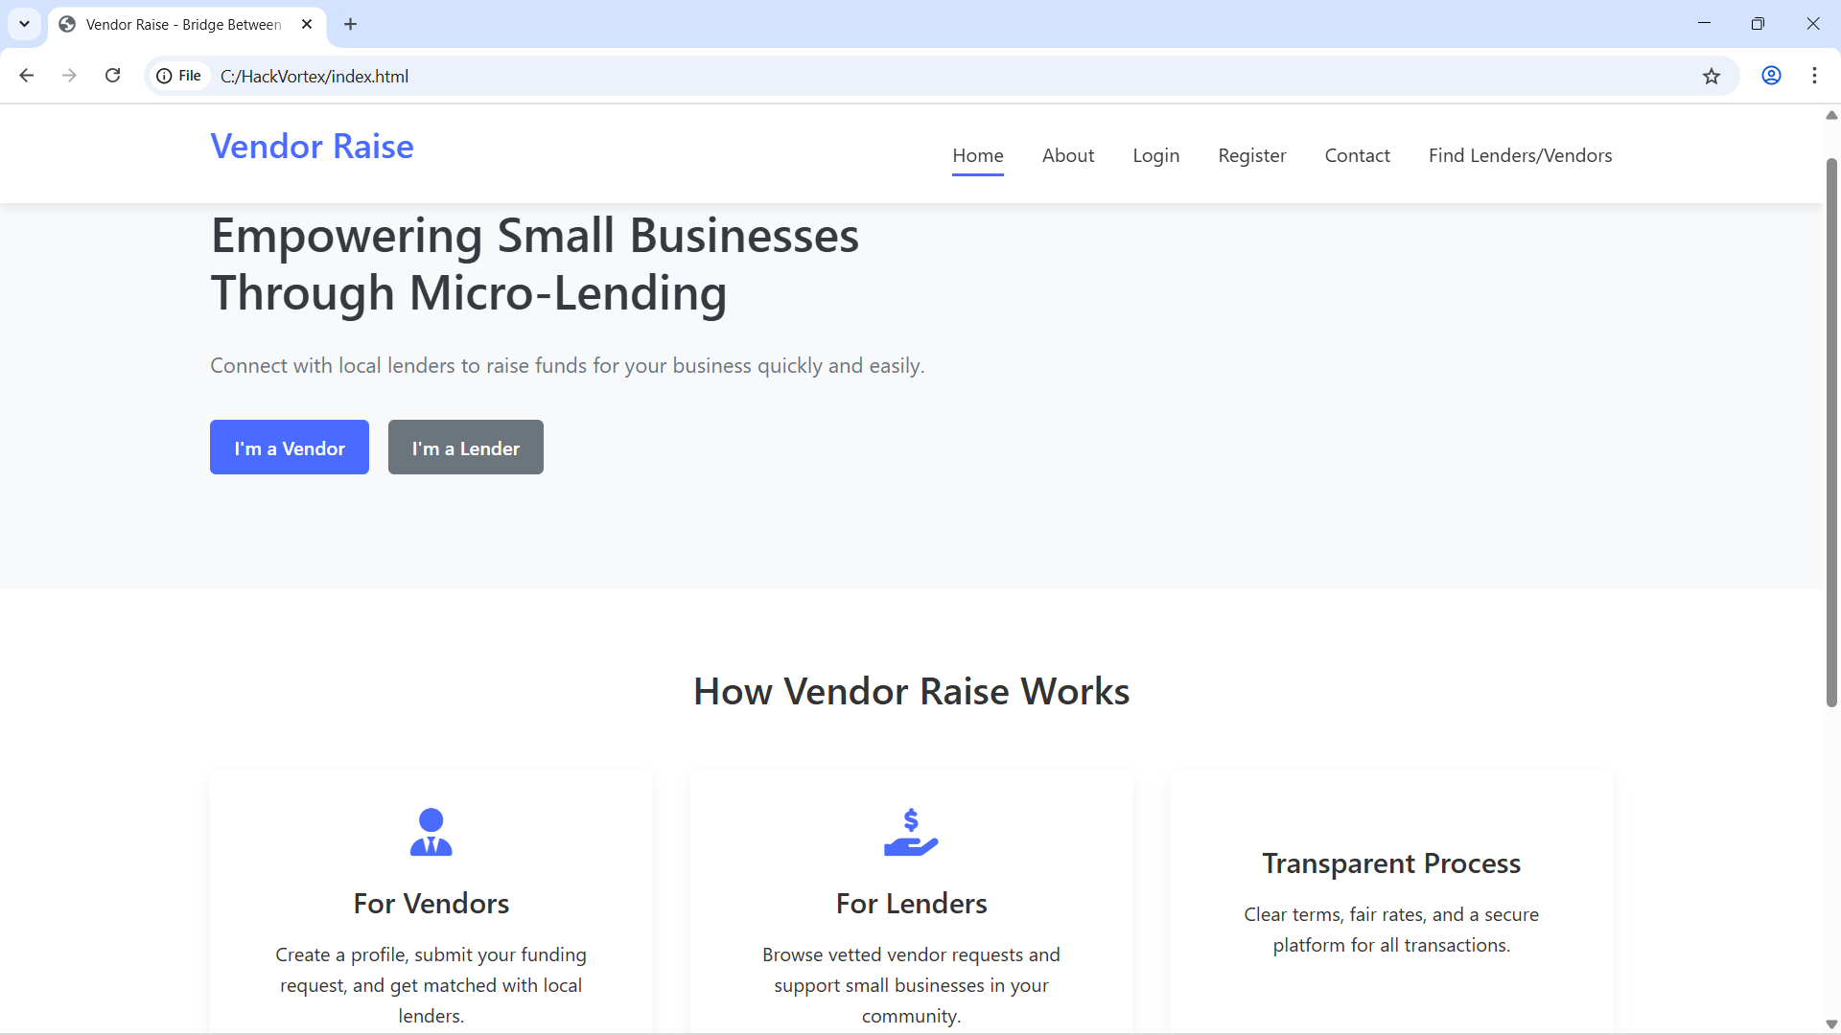
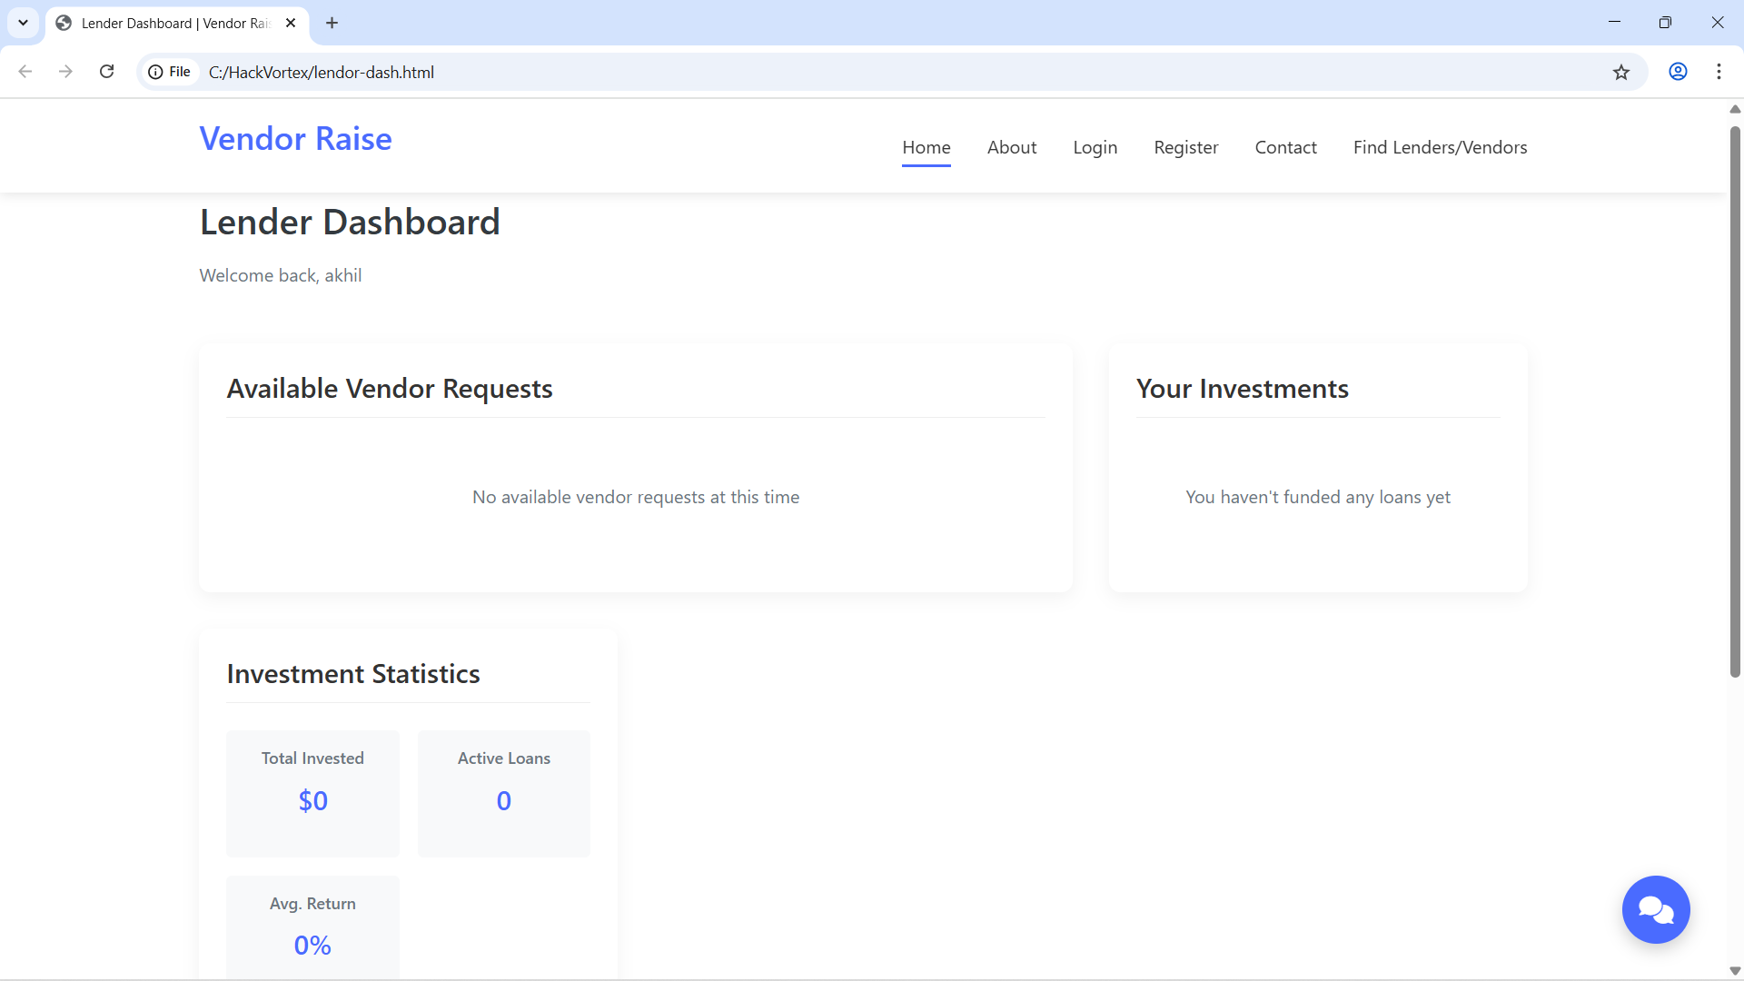
Screenshots

Slide 10

TEAM CREED
Team Leader: Akhil Duggineni
📞 +91 90328 55330
📧 duggineniakhil1@gmail.com
Amrita Vishwa Vidyapeetham, Coimbatore
Member: Kuchipudi Yokshith Sai Ram Chowdary
📞 +91 81792 94116
📧 chowdaryk399@gmail.com
Amrita Vishwa Vidyapeetham, Coimbatore

Slide 11
GITHUB LINK: https://github.com/Duggineniakhil/Vendor-Rise

